Slide 1
VTL IM

Slide 2
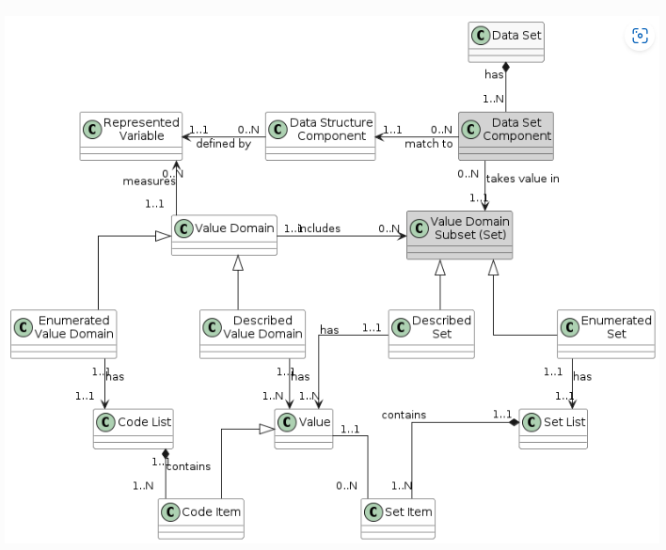
The issue

Slide 3
The practical problems
Needing to define ex-ante the variables. We have transformation schems with over 200 non-persistent datasets, and lots of non-persistent variables. Why should users define them?
Potential conflicts. When using datasets from different agencies, how can we ensure that they don’t use same variable names for different things? Dealing with this would imply dealing with agencies in the VTL.
Incompatibility with SDMX. In SDMX, concepts may be associated to different representations in different datasets. For instance, OBS_VALUE typically has different representations. This would imply that, to use datasets with different OBS_VALUE, something would need to be done outside VTL to deal with these situations.

Slide 4
Why I think there are no advantages
Separation of concerns: I strongly support the idea of variables (concepts) being defined once and associated to a valuedomain (codelist or representation)… But in the data dictionary, not in VTL. The input and output datasets will likely be defined in a dictionary, and it is there where this should be kept (also dealing with agencies).
Does not make it incompatible with DDI: The fact that DDI is stricter that VTL does not make the information model incompatibles. In fact, the problem is the other way around, what happens with SDMX, when it is less strict

Slide 5
Proposal (in order of preference)
1. Remove from the IM everything related to Represented Variable
2. Keep it, but specify that this is a conceptual link that should be ensured in the data dictionaries, but has no practical implications to VTL
3. Change the cardinality in the relationship between Data Structure Component and Represented Variable, to be 0..1, like in SDMX

Slide 6
DataStructure
External dataset definition
DataStructureComponent
Name
Data type
Representied Varialbes
0..1
ValueDomain

